Slide 1
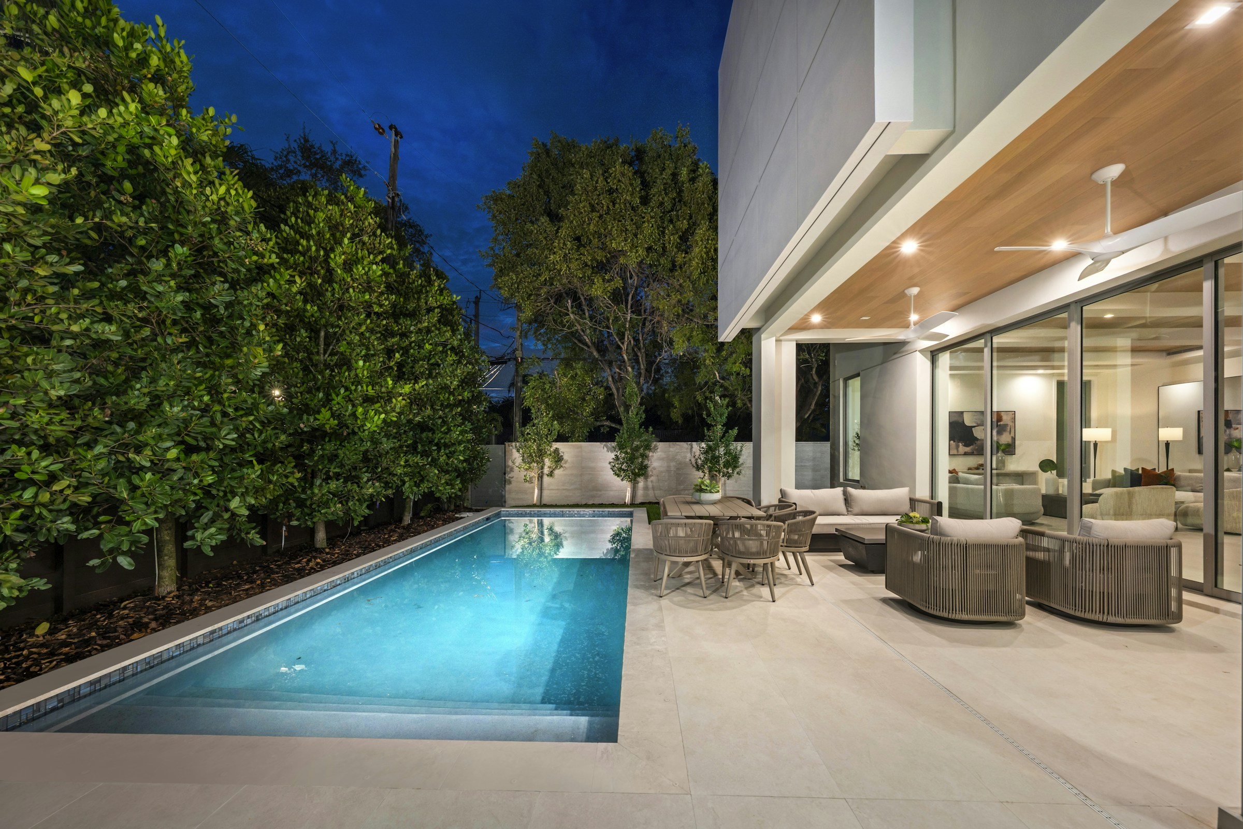
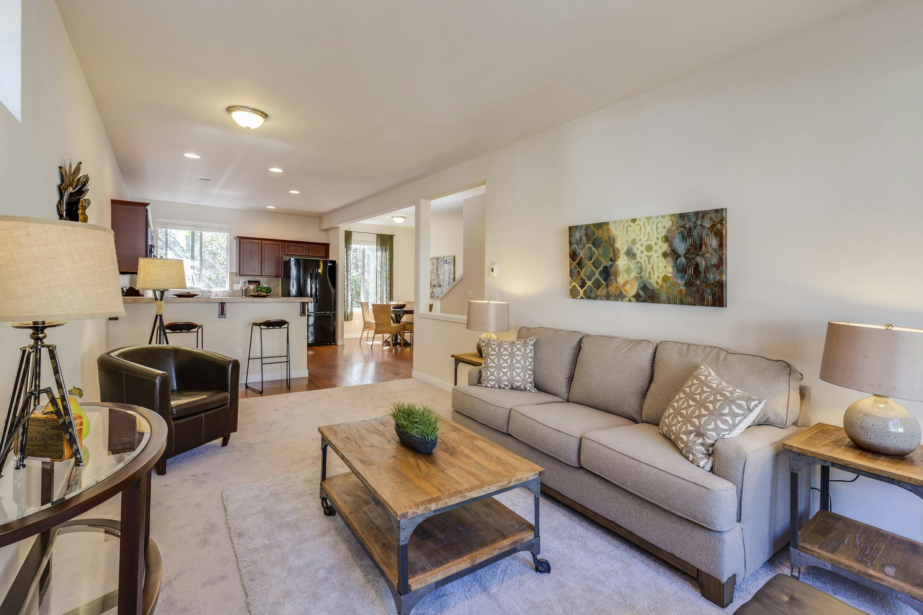
Forma
FORMA
Residential concept
PESCAO / GENERIC DESIGN SAMPLE
Notes:
Fictional presentation design sample adapted by Pescao. The supplied Real Estate template is a composition reference. Photography is a visual mood reference, not a named property, commissioned client, Pescao staff or evidence of performance. RETRATO INMOBILIARIO: https://unsplash.com/photos/modern-home-with-pool-and-outdoor-seating-area-_ELoYrhi3ao
Francesca Tosolini: https://unsplash.com/photos/living-room-interior-6japTIjUQoI

Slide 2
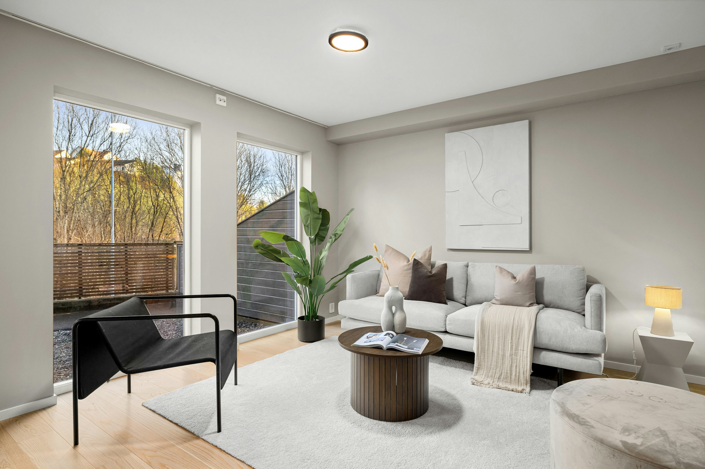
A sense
of place
Light, flow and quiet corners shape the way a home feels.
Design study
Notes:
Fictional presentation design sample adapted by Pescao. The supplied Real Estate template is a composition reference. Photography is a visual mood reference, not a named property, commissioned client, Pescao staff or evidence of performance. RETRATO INMOBILIARIO: https://unsplash.com/photos/modern-home-with-pool-and-outdoor-seating-area-_ELoYrhi3ao
Francesca Tosolini: https://unsplash.com/photos/living-room-interior-6japTIjUQoI
Alex Tyson: https://unsplash.com/photos/a-living-room-filled-with-furniture-and-a-large-window-vGLUZotkE4Q

Slide 3
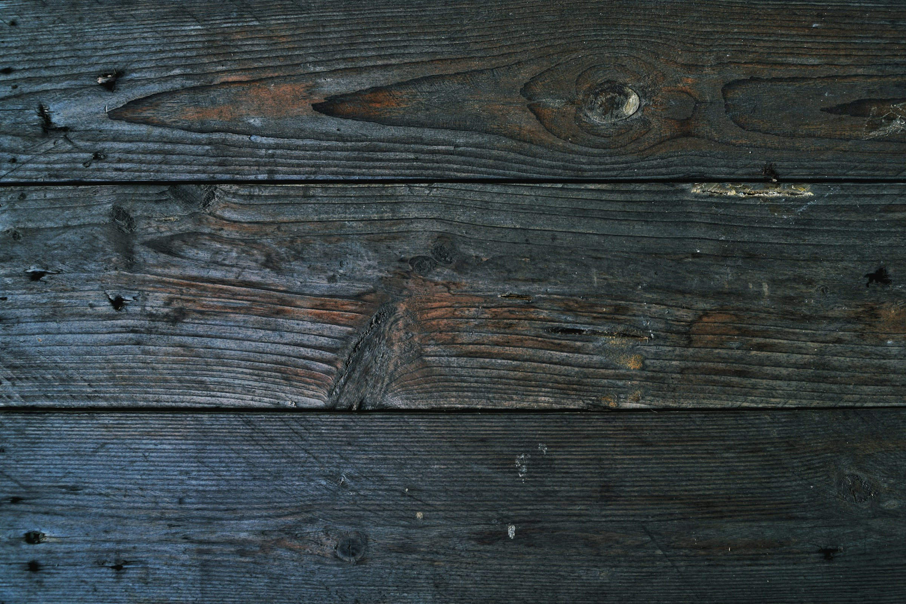
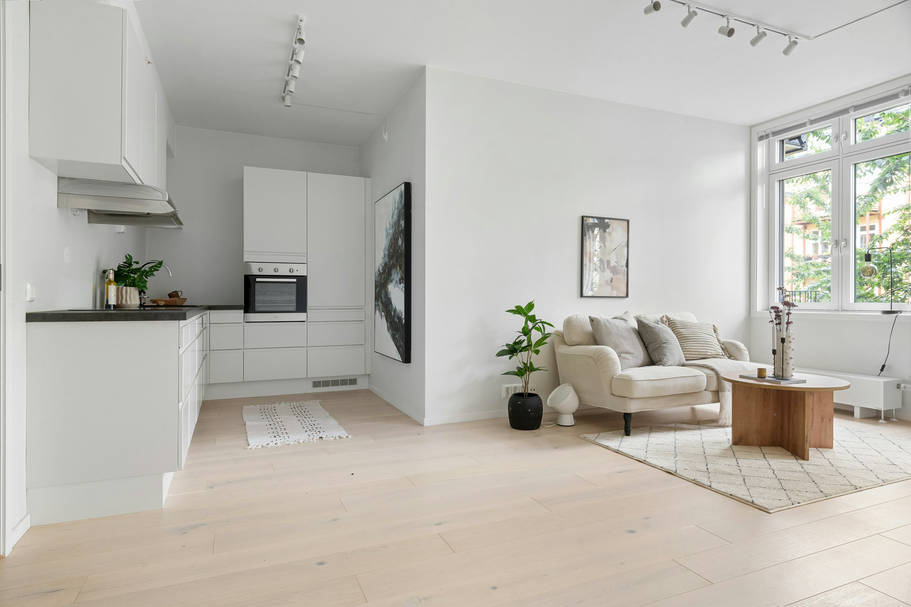
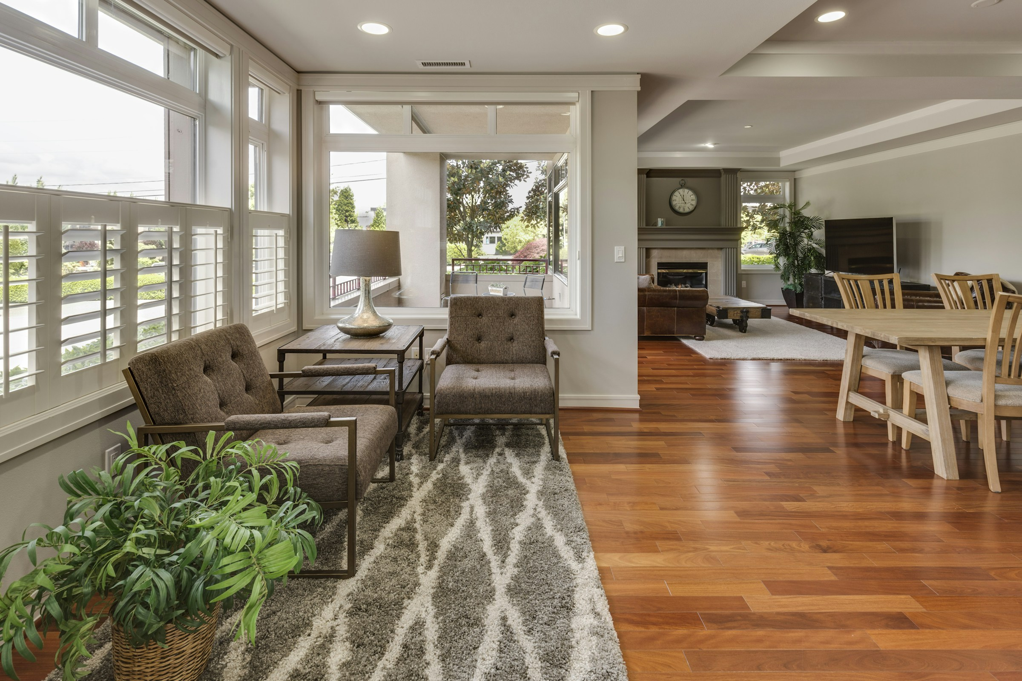
Warm grain and soft light create an inviting atmosphere.
Material direction
Warm materials.
A restrained palette.
Materials
Notes:
Fictional presentation design sample adapted by Pescao. The supplied Real Estate template is a composition reference. Photography is a visual mood reference, not a named property, commissioned client, Pescao staff or evidence of performance. RETRATO INMOBILIARIO: https://unsplash.com/photos/modern-home-with-pool-and-outdoor-seating-area-_ELoYrhi3ao
Francesca Tosolini: https://unsplash.com/photos/living-room-interior-6japTIjUQoI
Alex Tyson: https://unsplash.com/photos/a-living-room-filled-with-furniture-and-a-large-window-vGLUZotkE4Q
Francesca Tosolini: https://unsplash.com/photos/interior-of-a-living-room-XyGvEj587Mc
Arwin Neil Baichoo: https://unsplash.com/photos/a-close-up-of-a-piece-of-wood-jG2SnS0lPt4
Alex Tyson: https://unsplash.com/photos/a-living-room-filled-with-furniture-and-a-large-window-IDakSqSTG4A

Slide 4
Space for
Open views and a comfortable rhythm guide this fictional residential concept.
Everyday life
Forma
Design sample
A residential story
Notes:
Fictional presentation design sample adapted by Pescao. The supplied Real Estate template is a composition reference. Photography is a visual mood reference, not a named property, commissioned client, Pescao staff or evidence of performance. RETRATO INMOBILIARIO: https://unsplash.com/photos/modern-home-with-pool-and-outdoor-seating-area-_ELoYrhi3ao
Francesca Tosolini: https://unsplash.com/photos/living-room-interior-6japTIjUQoI
Alex Tyson: https://unsplash.com/photos/a-living-room-filled-with-furniture-and-a-large-window-vGLUZotkE4Q
Francesca Tosolini: https://unsplash.com/photos/interior-of-a-living-room-XyGvEj587Mc
Arwin Neil Baichoo: https://unsplash.com/photos/a-close-up-of-a-piece-of-wood-jG2SnS0lPt4
Alex Tyson: https://unsplash.com/photos/a-living-room-filled-with-furniture-and-a-large-window-IDakSqSTG4A

Slide 5
Considered details
Natural light
A softer connection between indoors and out.
Tactile materials
Warm surfaces give the space character.
Everyday comfort
A clear layout supports work, rest and time together.
Notes:
Fictional presentation design sample adapted by Pescao. The supplied Real Estate template is a composition reference. Photography is a visual mood reference, not a named property, commissioned client, Pescao staff or evidence of performance. RETRATO INMOBILIARIO: https://unsplash.com/photos/modern-home-with-pool-and-outdoor-seating-area-_ELoYrhi3ao
Francesca Tosolini: https://unsplash.com/photos/living-room-interior-6japTIjUQoI
Alex Tyson: https://unsplash.com/photos/a-living-room-filled-with-furniture-and-a-large-window-vGLUZotkE4Q
Francesca Tosolini: https://unsplash.com/photos/interior-of-a-living-room-XyGvEj587Mc
Arwin Neil Baichoo: https://unsplash.com/photos/a-close-up-of-a-piece-of-wood-jG2SnS0lPt4
Alex Tyson: https://unsplash.com/photos/a-living-room-filled-with-furniture-and-a-large-window-IDakSqSTG4A

Slide 6
Space, light and material give the concept its atmosphere.
Visual references
Quiet tones and
natural textures.
Notes:
Fictional presentation design sample adapted by Pescao. The supplied Real Estate template is a composition reference. Photography is a visual mood reference, not a named property, commissioned client, Pescao staff or evidence of performance. RETRATO INMOBILIARIO: https://unsplash.com/photos/modern-home-with-pool-and-outdoor-seating-area-_ELoYrhi3ao
Francesca Tosolini: https://unsplash.com/photos/living-room-interior-6japTIjUQoI
Alex Tyson: https://unsplash.com/photos/a-living-room-filled-with-furniture-and-a-large-window-vGLUZotkE4Q
Francesca Tosolini: https://unsplash.com/photos/interior-of-a-living-room-XyGvEj587Mc
Arwin Neil Baichoo: https://unsplash.com/photos/a-close-up-of-a-piece-of-wood-jG2SnS0lPt4
Alex Tyson: https://unsplash.com/photos/a-living-room-filled-with-furniture-and-a-large-window-IDakSqSTG4A

Slide 7
A clear decision journey
01
03
The place
The details
Understand the context and surroundings.
Discuss materials, layouts and priorities.
02
04
The space
The next step
Explore the atmosphere and everyday use.
Bring the questions to a conversation.
Notes:
Fictional presentation design sample adapted by Pescao. The supplied Real Estate template is a composition reference. Photography is a visual mood reference, not a named property, commissioned client, Pescao staff or evidence of performance. RETRATO INMOBILIARIO: https://unsplash.com/photos/modern-home-with-pool-and-outdoor-seating-area-_ELoYrhi3ao
Francesca Tosolini: https://unsplash.com/photos/living-room-interior-6japTIjUQoI
Alex Tyson: https://unsplash.com/photos/a-living-room-filled-with-furniture-and-a-large-window-vGLUZotkE4Q
Francesca Tosolini: https://unsplash.com/photos/interior-of-a-living-room-XyGvEj587Mc
Arwin Neil Baichoo: https://unsplash.com/photos/a-close-up-of-a-piece-of-wood-jG2SnS0lPt4
Alex Tyson: https://unsplash.com/photos/a-living-room-filled-with-furniture-and-a-large-window-IDakSqSTG4A

Slide 8
Forma
PESCAO / FORMA
Imagine your everyday
The idea
The story
The format
A quieter rhythm
Residential concept
Visual mood references
Generic design sample
PESCAO / GENERIC DESIGN SAMPLE
08
Notes:
Fictional presentation design sample adapted by Pescao. The supplied Real Estate template is a composition reference. Photography is a visual mood reference, not a named property, commissioned client, Pescao staff or evidence of performance. RETRATO INMOBILIARIO: https://unsplash.com/photos/modern-home-with-pool-and-outdoor-seating-area-_ELoYrhi3ao
Francesca Tosolini: https://unsplash.com/photos/living-room-interior-6japTIjUQoI
Alex Tyson: https://unsplash.com/photos/a-living-room-filled-with-furniture-and-a-large-window-vGLUZotkE4Q
Francesca Tosolini: https://unsplash.com/photos/interior-of-a-living-room-XyGvEj587Mc
Arwin Neil Baichoo: https://unsplash.com/photos/a-close-up-of-a-piece-of-wood-jG2SnS0lPt4
Alex Tyson: https://unsplash.com/photos/a-living-room-filled-with-furniture-and-a-large-window-IDakSqSTG4A

