Slide 1
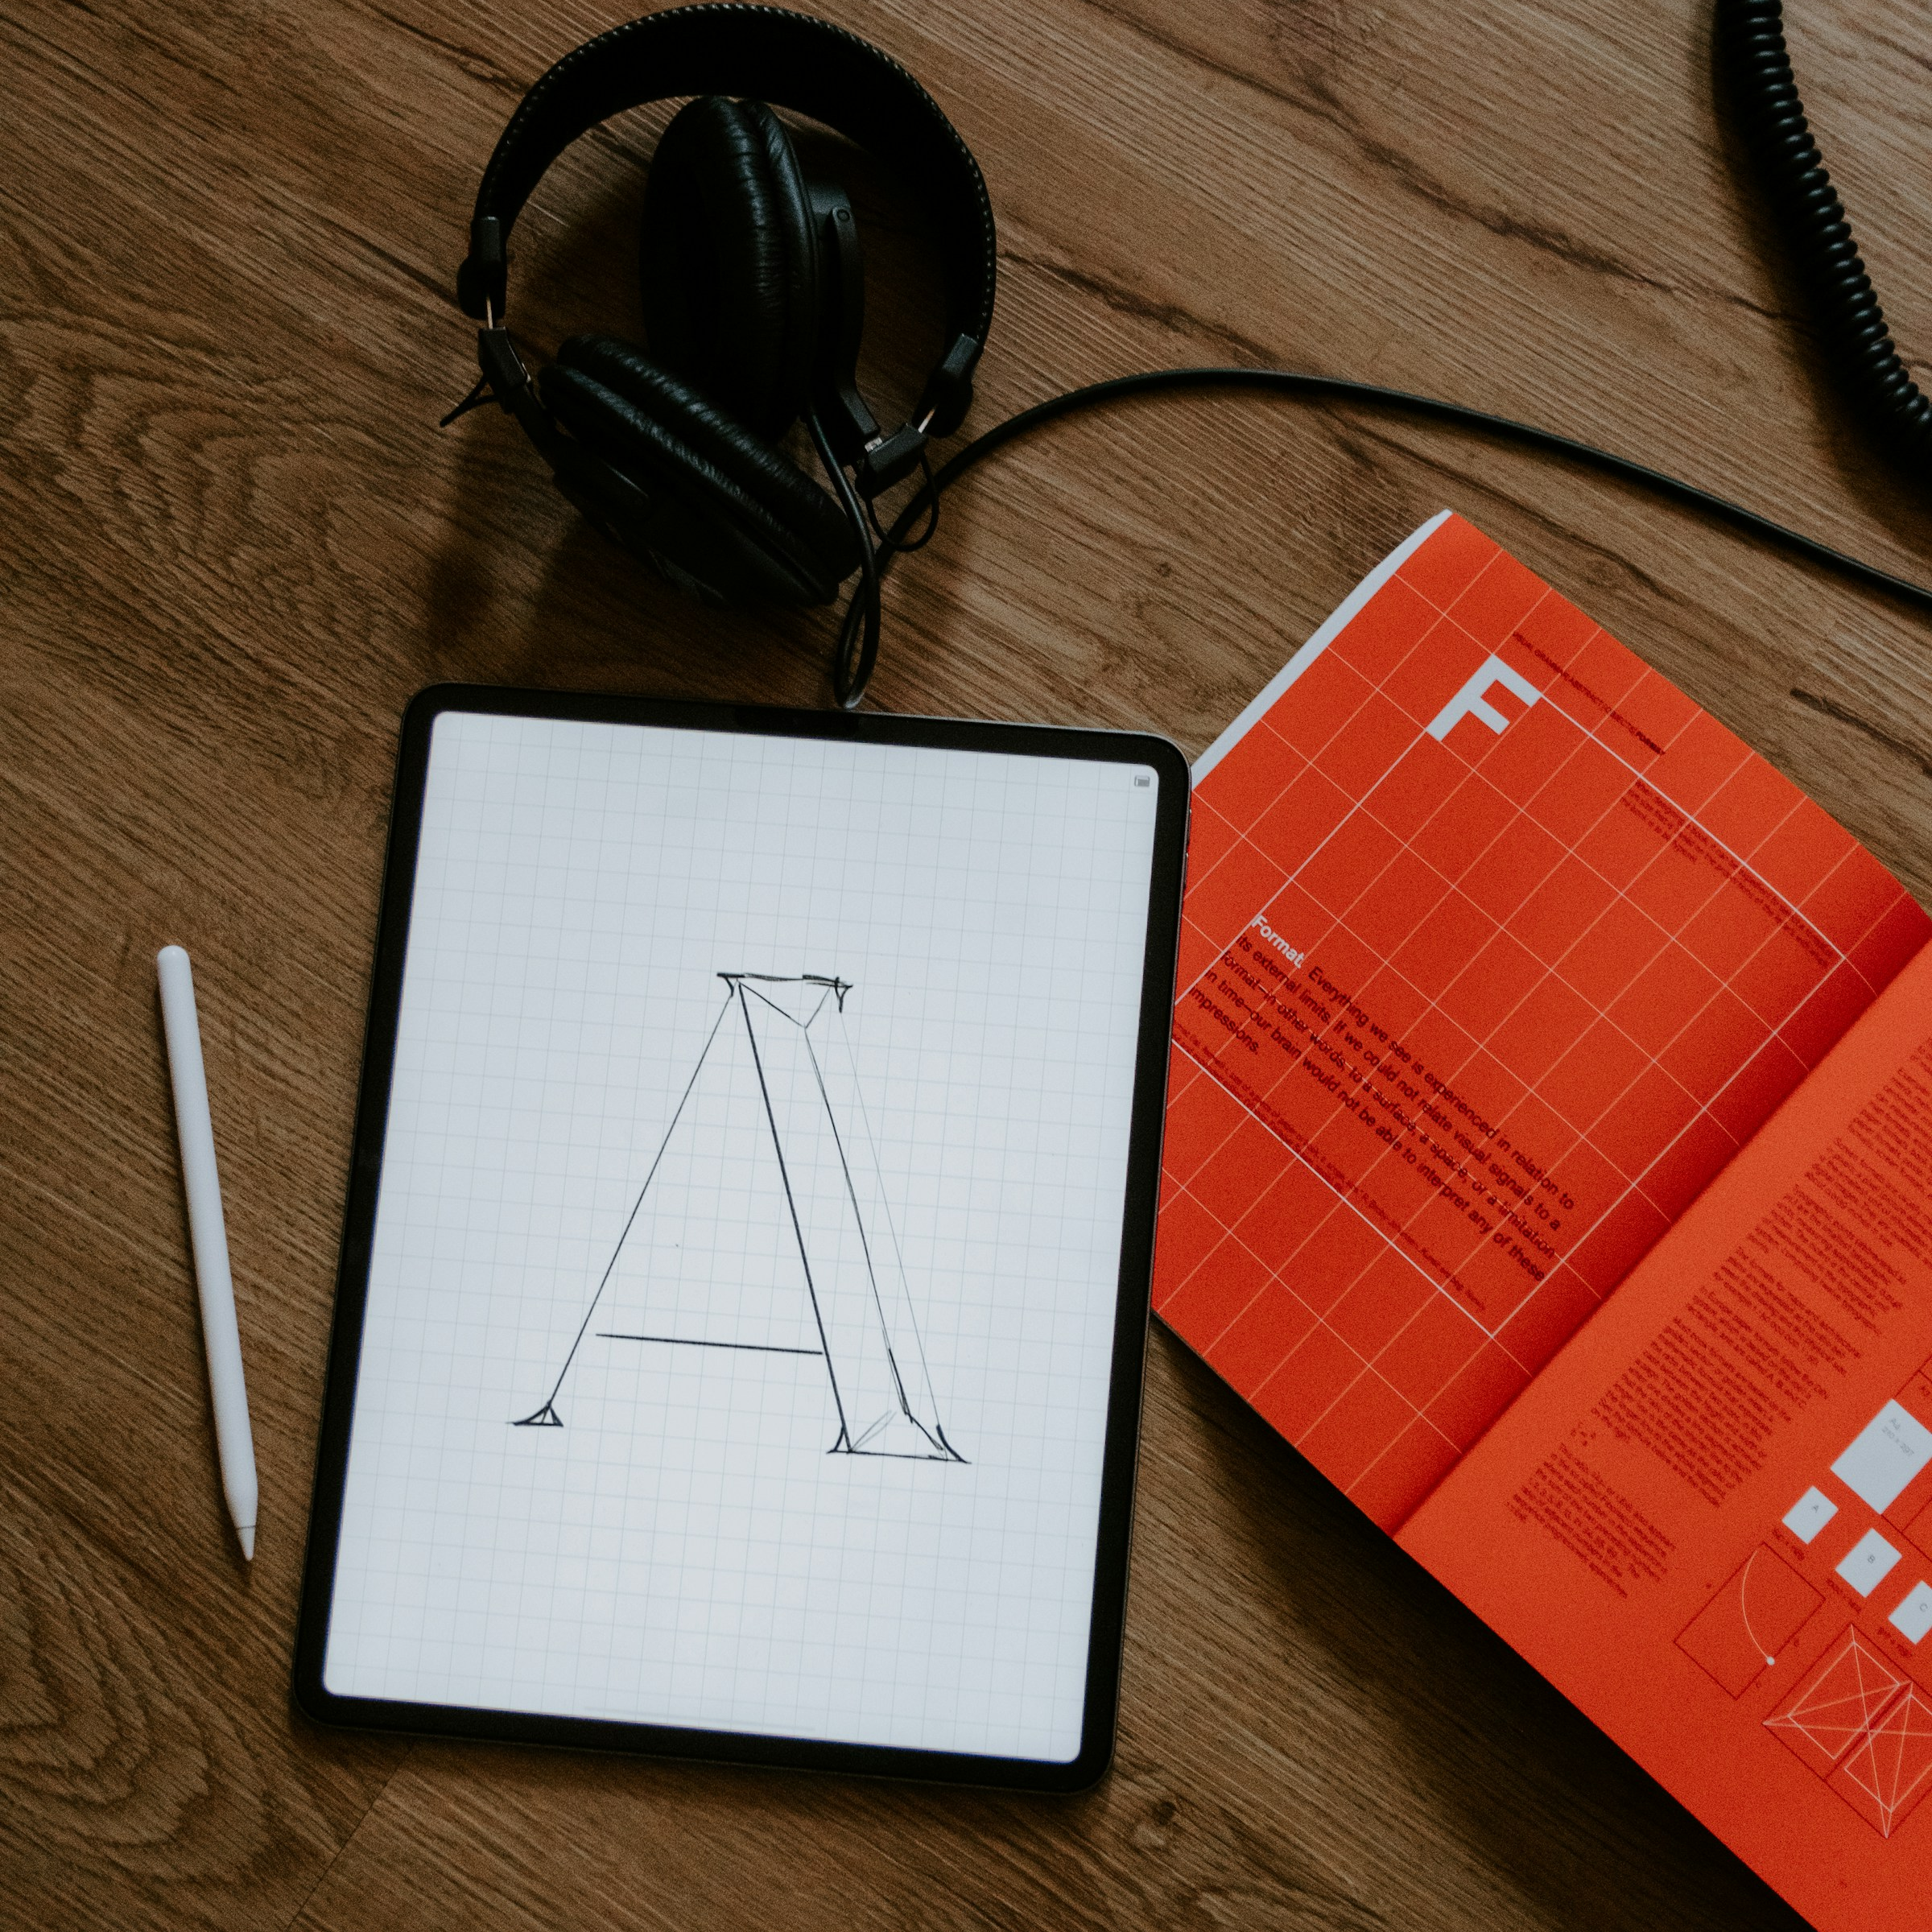
Creative
Next
A brand proposal
Presented by:
Pescao Studio
Fictional brief
Design sample
PESCAO / NEXT / GENERIC DESIGN SAMPLE
Notes:
Fictional presentation design sample adapted by Pescao. The supplied Marketing Plan template is a composition reference. Photography is a visual mood reference, not a named property, commissioned client, Pescao staff or evidence of performance. Kelly Sikkema: https://unsplash.com/photos/tablet-with-sketch-and-orange-book-IkHwu5xLXxs

Slide 2

The
A clear direction
Ambition
A fictional brand wants a clearer presence. This proposal connects its message, visual language and first launch materials.
PESCAO / NEXT / GENERIC DESIGN SAMPLE
Notes:
Fictional presentation design sample adapted by Pescao. The supplied Marketing Plan template is a composition reference. Photography is a visual mood reference, not a named property, commissioned client, Pescao staff or evidence of performance. Kelly Sikkema: https://unsplash.com/photos/tablet-with-sketch-and-orange-book-IkHwu5xLXxs
Vitaly Gariev: https://unsplash.com/photos/creative-team-meeting-in-office-oiXwUNp-a_k

Slide 3

The
Brief
Position
Audience
Define the message people should remember.
Understand the audience and the task.
Expression
Priorities
Explore a distinct visual language.
Agree what needs to launch first.
PESCAO / NEXT / GENERIC DESIGN SAMPLE
Notes:
Fictional presentation design sample adapted by Pescao. The supplied Marketing Plan template is a composition reference. Photography is a visual mood reference, not a named property, commissioned client, Pescao staff or evidence of performance. Kelly Sikkema: https://unsplash.com/photos/tablet-with-sketch-and-orange-book-IkHwu5xLXxs
Vitaly Gariev: https://unsplash.com/photos/creative-team-meeting-in-office-oiXwUNp-a_k
Kelly Sikkema: https://unsplash.com/photos/person-writing-on-white-paper-9j7Xm9hUvwo

Slide 4
Brand
Position
A useful position connects an audience need with something the brand can deliver. The creative direction gives that connection a recognisable voice.
What people
need
What the
brand offers
PESCAO / NEXT / GENERIC DESIGN SAMPLE
Notes:
Fictional presentation design sample adapted by Pescao. The supplied Marketing Plan template is a composition reference. Photography is a visual mood reference, not a named property, commissioned client, Pescao staff or evidence of performance. Kelly Sikkema: https://unsplash.com/photos/tablet-with-sketch-and-orange-book-IkHwu5xLXxs
Vitaly Gariev: https://unsplash.com/photos/creative-team-meeting-in-office-oiXwUNp-a_k
Kelly Sikkema: https://unsplash.com/photos/person-writing-on-white-paper-9j7Xm9hUvwo

Slide 5


Visual
Language
Typography, image choice and colour create a consistent point of view. Every application should feel like part of the same brand.
Principle
One voice
PESCAO / NEXT / GENERIC DESIGN SAMPLE
Notes:
Fictional presentation design sample adapted by Pescao. The supplied Marketing Plan template is a composition reference. Photography is a visual mood reference, not a named property, commissioned client, Pescao staff or evidence of performance. Kelly Sikkema: https://unsplash.com/photos/tablet-with-sketch-and-orange-book-IkHwu5xLXxs
Vitaly Gariev: https://unsplash.com/photos/creative-team-meeting-in-office-oiXwUNp-a_k
Kelly Sikkema: https://unsplash.com/photos/person-writing-on-white-paper-9j7Xm9hUvwo
Patrik Michalicka: https://unsplash.com/photos/workspace-desk-with-keyboard-and-laptop-r3iAqHb7JWs
Kelly Sikkema: https://unsplash.com/photos/a-person-drawing-a-diagram-on-a-piece-of-paper-lFtttcsx5Vk

Slide 6
Creative
Scope
The first release gives the brand a clear foundation and a useful digital presence.
Each deliverable follows the same direction, with files organised for everyday use.
Brand
Digital
Launch
Positioning, tone, typography and colour.
A clear website journey and content structure.
A coordinated set of presentation and launch assets.
PESCAO / NEXT / GENERIC DESIGN SAMPLE
Notes:
Fictional presentation design sample adapted by Pescao. The supplied Marketing Plan template is a composition reference. Photography is a visual mood reference, not a named property, commissioned client, Pescao staff or evidence of performance. Kelly Sikkema: https://unsplash.com/photos/tablet-with-sketch-and-orange-book-IkHwu5xLXxs
Vitaly Gariev: https://unsplash.com/photos/creative-team-meeting-in-office-oiXwUNp-a_k
Kelly Sikkema: https://unsplash.com/photos/person-writing-on-white-paper-9j7Xm9hUvwo
Patrik Michalicka: https://unsplash.com/photos/workspace-desk-with-keyboard-and-laptop-r3iAqHb7JWs
Kelly Sikkema: https://unsplash.com/photos/a-person-drawing-a-diagram-on-a-piece-of-paper-lFtttcsx5Vk

Slide 7

Collaboration
and Delivery
01
Alignment
A focused brief sets the audience, priorities and creative direction.
02
Handoff
Review the applications, refine the details and organise the final files.
PESCAO / NEXT / GENERIC DESIGN SAMPLE
Notes:
Fictional presentation design sample adapted by Pescao. The supplied Marketing Plan template is a composition reference. Photography is a visual mood reference, not a named property, commissioned client, Pescao staff or evidence of performance. Kelly Sikkema: https://unsplash.com/photos/tablet-with-sketch-and-orange-book-IkHwu5xLXxs
Vitaly Gariev: https://unsplash.com/photos/creative-team-meeting-in-office-oiXwUNp-a_k
Kelly Sikkema: https://unsplash.com/photos/person-writing-on-white-paper-9j7Xm9hUvwo
Patrik Michalicka: https://unsplash.com/photos/workspace-desk-with-keyboard-and-laptop-r3iAqHb7JWs
Kelly Sikkema: https://unsplash.com/photos/a-person-drawing-a-diagram-on-a-piece-of-paper-lFtttcsx5Vk
Kelly Sikkema: https://unsplash.com/photos/yellow-click-pen-on-white-printer-paper-gcHFXsdcmJE

Slide 8
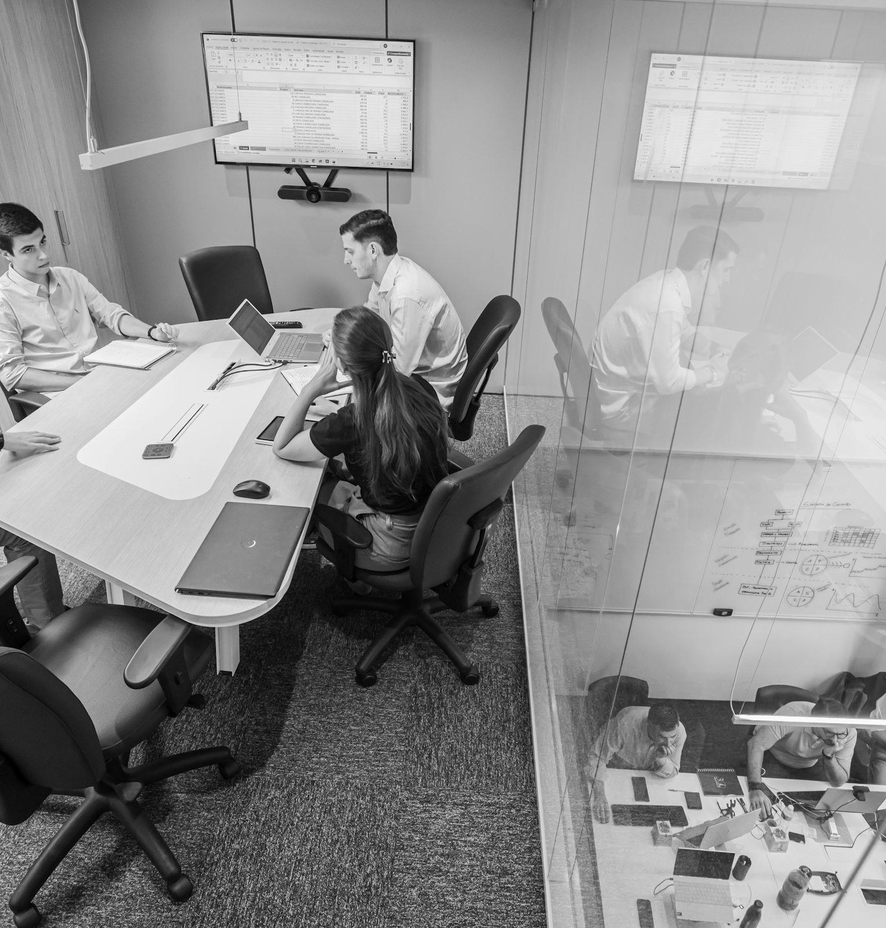
What’s
Next?
A better brand conversation
PESCAO / NEXT / GENERIC DESIGN SAMPLE
Notes:
Fictional presentation design sample adapted by Pescao. The supplied Marketing Plan template is a composition reference. Photography is a visual mood reference, not a named property, commissioned client, Pescao staff or evidence of performance. Kelly Sikkema: https://unsplash.com/photos/tablet-with-sketch-and-orange-book-IkHwu5xLXxs
Vitaly Gariev: https://unsplash.com/photos/creative-team-meeting-in-office-oiXwUNp-a_k
Kelly Sikkema: https://unsplash.com/photos/person-writing-on-white-paper-9j7Xm9hUvwo
Patrik Michalicka: https://unsplash.com/photos/workspace-desk-with-keyboard-and-laptop-r3iAqHb7JWs
Kelly Sikkema: https://unsplash.com/photos/a-person-drawing-a-diagram-on-a-piece-of-paper-lFtttcsx5Vk
Kelly Sikkema: https://unsplash.com/photos/yellow-click-pen-on-white-printer-paper-gcHFXsdcmJE
Beatriz Cattel: https://unsplash.com/photos/team-meeting-in-a-modern-conference-room-aNTsx7Fl4T0

