Slide 1

SIGNAL / PRODUCT PITCH
Good work.
Less friction.
A calmer way to keep a team moving.
PESCAO / SIGNAL DESIGN SAMPLE
01
Notes:
Generic presentation sample by Pescao. Fictional brief: no commissioned project or performance claim. Photography: Dell, https://unsplash.com/photos/workspace-with-laptop-and-monitor-g2E2NQ5SWSU. Free Unsplash photograph: https://unsplash.com/license. Images are mood references, not photographs of a named property, Pescao staff or a Signal product.

Slide 2

THE PROBLEM
Too many tools.
Too little
continuity.
A brief in one place. Decisions in another.
The next action somewhere else.
PESCAO / SIGNAL DESIGN SAMPLE
02
Notes:
Generic presentation sample by Pescao. Fictional brief: no commissioned project or performance claim. Photography: Patrik Michalicka, https://unsplash.com/photos/workspace-desk-with-keyboard-and-laptop-r3iAqHb7JWs. Free Unsplash photograph: https://unsplash.com/license. Images are mood references, not photographs of a named property, Pescao staff or a Signal product.

Slide 3
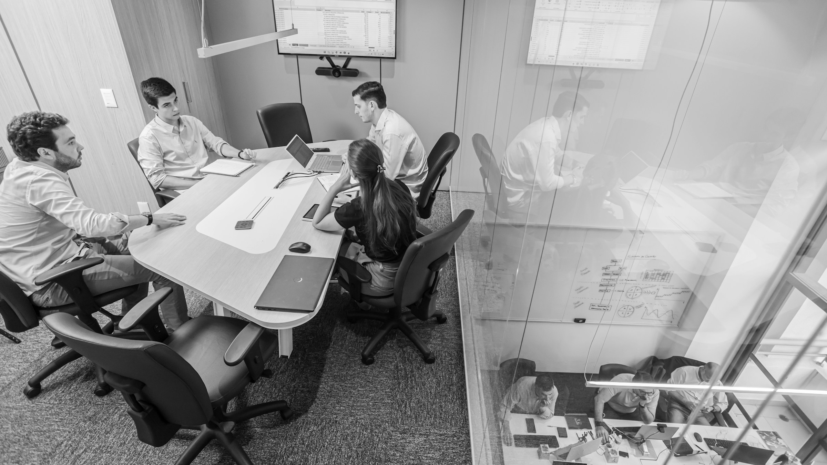
THE IDEA
A shared place
for the next step.
Keep the brief, the decision and the action connected.
PESCAO / SIGNAL DESIGN SAMPLE
03
Notes:
Generic presentation sample by Pescao. Fictional brief: no commissioned project or performance claim. Photography: Beatriz Cattel, https://unsplash.com/photos/team-meeting-in-a-modern-conference-room-aNTsx7Fl4T0. Free Unsplash photograph: https://unsplash.com/license. Images are mood references, not photographs of a named property, Pescao staff or a Signal product.

Slide 4
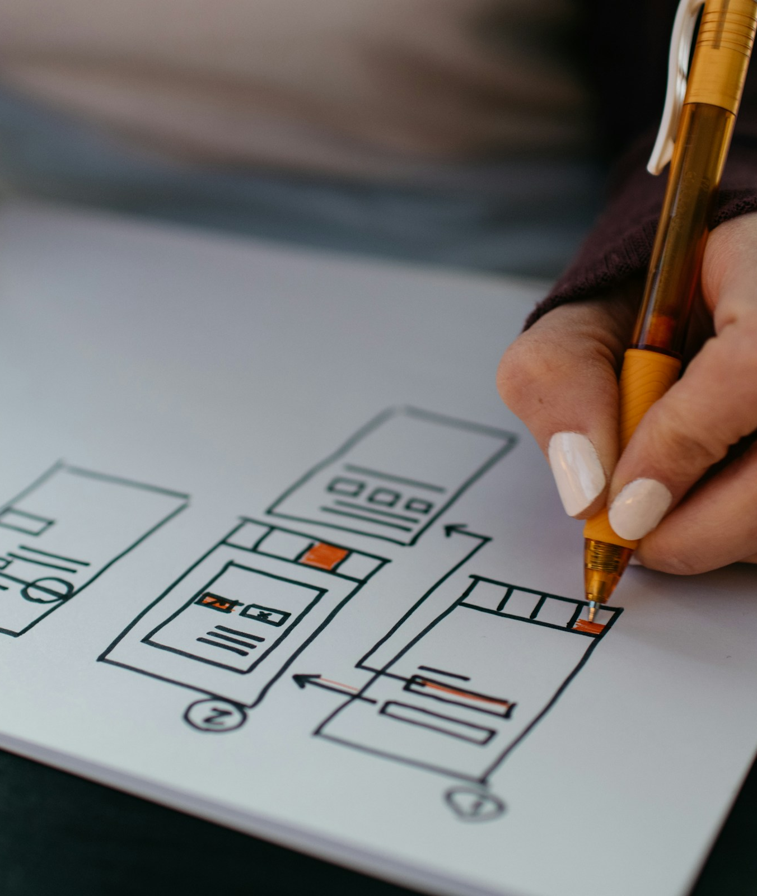
EXPERIENCE FIRST
Start with
the human
journey.
Understand the task. Remove unnecessary
steps. Make the next action clear.
PESCAO / SIGNAL DESIGN SAMPLE
04
Notes:
Generic presentation sample by Pescao. Fictional brief: no commissioned project or performance claim. Photography: Kelly Sikkema, https://unsplash.com/photos/yellow-click-pen-on-white-printer-paper-gcHFXsdcmJE. Free Unsplash photograph: https://unsplash.com/license. Images are mood references, not photographs of a named property, Pescao staff or a Signal product.

Slide 5
A SIMPLE PRODUCT PROMISE
Collect. Connect. Move.
01
Collect
Capture the brief and useful context.
02
Connect
Bring decisions and conversations together.
03
Move
Make ownership and the next action visible.
PESCAO / SIGNAL DESIGN SAMPLE
05
Notes:
Generic presentation sample by Pescao. All briefs are fictional; this is presentation design, not commissioned client work.

Slide 6
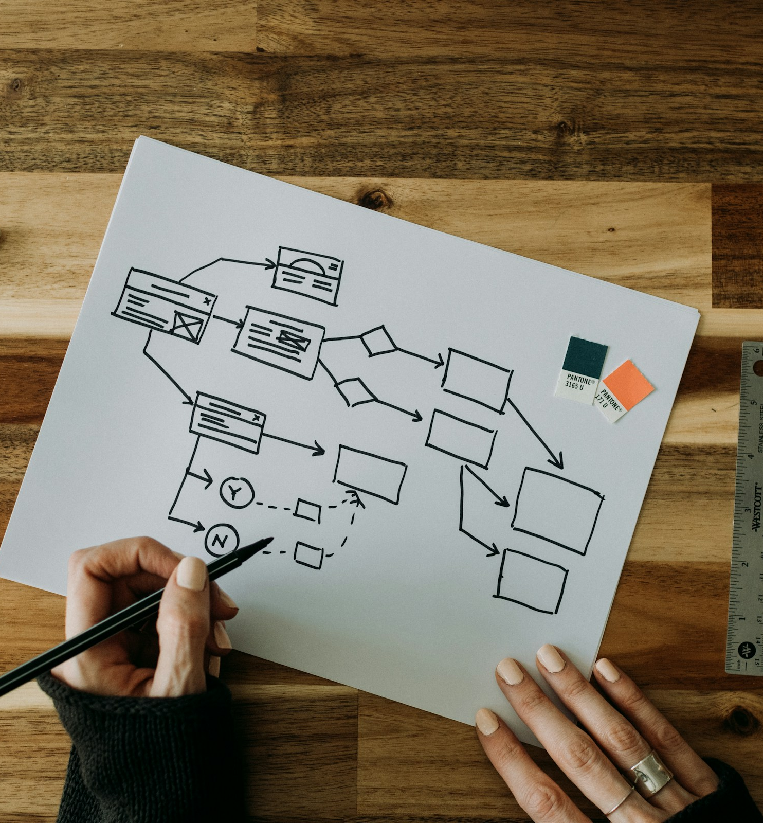
PRODUCT PRINCIPLES
Clarity is
a product
feature.
One clear purpose per screen.
Useful context at the right moment.
A visible path forward.
PESCAO / SIGNAL DESIGN SAMPLE
06
Notes:
Generic presentation sample by Pescao. Fictional brief: no commissioned project or performance claim. Photography: Kelly Sikkema, https://unsplash.com/photos/a-person-drawing-a-diagram-on-a-piece-of-paper-lFtttcsx5Vk. Free Unsplash photograph: https://unsplash.com/license. Images are mood references, not photographs of a named property, Pescao staff or a Signal product.

Slide 7
A CONSIDERED WAY TO BUILD
Learn before scaling.
01
Understand
Listen, map the work and define the first useful task.
02
Prototype
Explore the journey with a focused, testable experience.
03
Refine
Use feedback to shape the next release.
PESCAO / SIGNAL DESIGN SAMPLE
07
Notes:
Generic presentation sample by Pescao. All briefs are fictional; this is presentation design, not commissioned client work.

Slide 8
SIGNAL / THE NEXT CONVERSATION
Make the next
step clear.
A focused concept. A useful prototype. A better conversation.
PESCAO / SIGNAL DESIGN SAMPLE
08
Notes:
Generic presentation sample by Pescao. Fictional brief: no commissioned project or performance claim. Photography: Dell, https://unsplash.com/photos/workspace-with-laptop-and-monitor-g2E2NQ5SWSU. Free Unsplash photograph: https://unsplash.com/license. Images are mood references, not photographs of a named property, Pescao staff or a Signal product.

